Slide 1

Week -2 : Agenda
JavaScript
TypeScript
Introduction to Angular Framework
Angular-ng g commands, folder structure
Lifecycle hooks

Slide 2
Topic Week 2 : JavaScript Fundamental’s
Data Types
JavaScript provides different data types to hold different types of values. There are two types of data types in JavaScript.
Primitive data type
Non-primitive (reference) data type
Primitive data types
String | represents sequence of characters e.g. "hello"
Number | represents numbers
Boolean | represents Boolean value either false or true
Undefined | represents undefined value
Null | represents null i.e., no value at all
Non-primitive data types
Object | represents instance through which we can access members
Array | represents group of similar values
RegExp | represents regular expression

Slide 3
Topic Week 2 : JavaScript Fundamental’s
Variable
A JavaScript variable is simply a name of storage location. There are two types of variables in JavaScript :
1. Local variable
2. Global variable.
There are some rules while declaring a JavaScript variable (also known as identifiers).
Name must start with a letter (a to z or A to Z), underscore( _ ), or dollar( $ ) sign.
After first letter we can use digits (0 to 9), for example value1.
JavaScript variables are case sensitive, for example x and X are different variables.

Slide 4

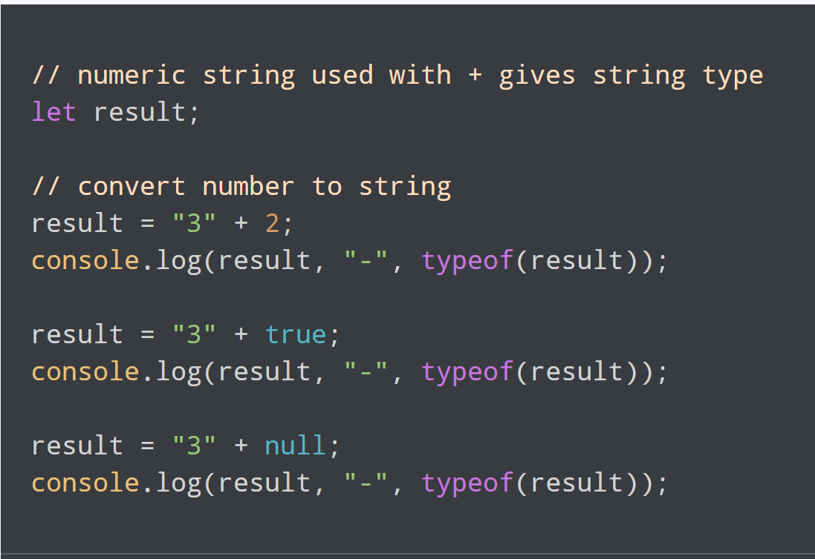
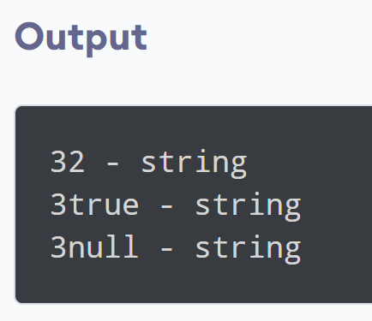
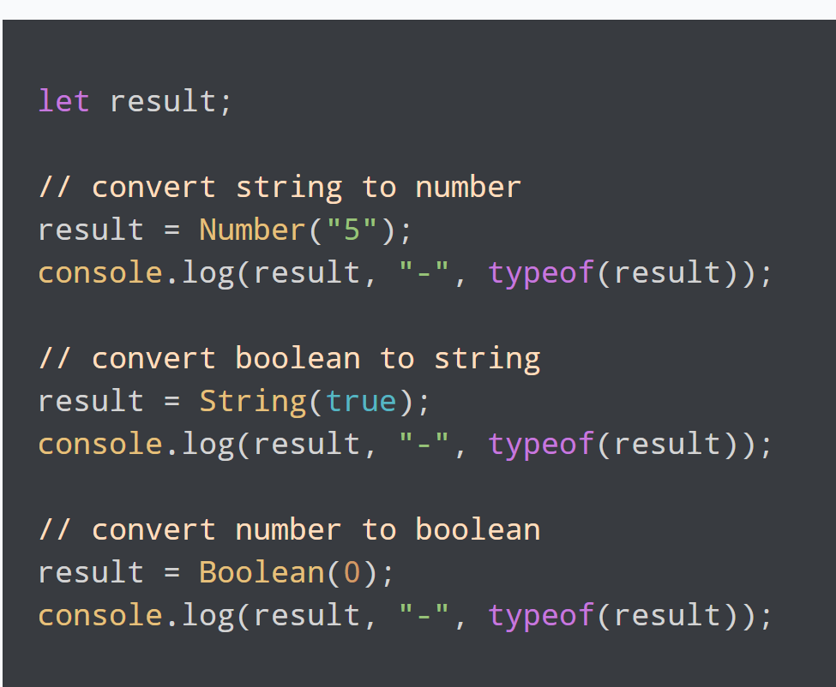
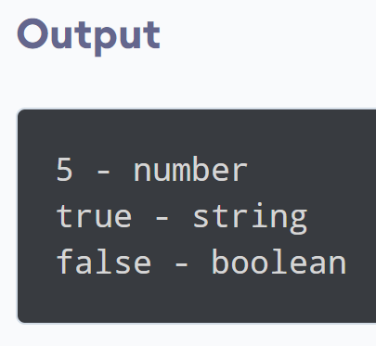
Topic Week 2: JavaScript Fundamentals
TypeConvertion
JavaScript frequently performs type conversions, either explicitly through coding patterns or implicitly by the JavaScript engine during runtime.
String Conversion
Numeric Conversion
Boolean Conversion

Slide 5
Topic Week 2: JavaScript Fundamentals
Comparisons
JavaScript comparisons are crucial for control flow, logic, and data validation. Understanding the nuances of comparison operations in JavaScript is essential for writing accurate and bug-free code.
Equality Comparisons
Relational Comparisons
Logical Operators
Equality Comparisons Loose Equality (==) : Strict Equality (===): Best Practice: Prefer === for most comparisons to avoid unexpected coercion.
Relational Comparisons Numeric Comparison: String Comparison: Mixed Type Comparison: Special Cases: NaN < 3; // false null == undefined; // true (equality comparison exception) null === undefined; // false
Logical Operators AND Operator (&&) OR Operator (||): NOT Operator (!):

Slide 6
Topic Week 2 : J avaScript F undamentals
Conditional branching: if, '?'
The conditional (ternary) operator is the only JavaScript operator that takes three operands. It's a concise way to express conditional statements.
The syntax consists of a condition followed by a question mark (?), then the expression to execute if the condition is truthy, followed by a colon (:), and finally the expression to execute if the condition is falsy.
condition ? exprIfTrue : exprIfFalse;
•Usage Example:
let result = (a > b) ? "a is greater" : "b is greater";
•Use Cases: Best used for simple conditional assignments and inline expressions. While it offers a more compact syntax, overuse or chaining multiple ternary operators can quickly lead to code that's difficult to read and maintain.
•Best Practices: Reserve the ternary operator for straightforward conditions and outcomes. For more complex conditional logic, use if statements or other control flow structures to enhance clarity. Remember, readability should not be sacrificed for brevity.

Slide 7
Topic Week 2 : J avaScript F undamentals
Functions
Functions in JavaScript are reusable blocks of code designed to perform a specific task. They are fundamental to JavaScript programming, allowing for more modular, maintainable, and readable code.
Syntax:
function functionName(parameters) {
// Code to be executed
}

Slide 8
Topic Week 2 : J avaScript F undamentals
Loops
Loops are a fundamental programming construct that allows the execution of a block of code repeatedly based on a specified condition. In JavaScript, loops improve code efficiency and readability by reducing the need for repetitive code.
Types of Loops in JavaScript
for Loop: for (let i = 0; i < 5; i++) { console.log(i); }
while Loop: let i = 0; while (i < 5) { console.log(i); i++; }
do...while Loop: let i = 0; do { console.log(i); i++; } while (i < 5);
for...in Loop const obj = {a: 1, b: 2, c: 3}; for (let prop in obj) { console.log(`obj.${prop} = ${obj[prop]}`); }
for...of Loop: const arr = [10, 20, 30]; for (let value of arr) { console.log(value); }

Slide 9
Topic Week 2 : J avaScript F undamentals
Events
JavaScript events are actions or occurrences that happen in the system you are programming for, which the system tells you about so your code can respond to them. Events are central to creating dynamic and interactive web experiences, allowing scripts to react to user inputs, API messages, and other triggers.
Common JavaScript Events
Mouse Events: click, dblclick, mouseover, mouseout, mousemove, etc. They respond to user interactions with a mouse or similar pointing devices.
Keyboard Events: keydown, keyup, keypress. These events trigger in response to user actions with the keyboard.
Form Events: submit, change, focus, blur. Important for handling form submissions and interactions.
Window Events: load, resize, scroll, unload. They relate to the window object and can trigger actions based on the window or viewport's state.

Slide 10

Topic Week 2 : TypeScript
Why use TypeScript?
TypeScript helps catch errors before they occur by adding static type checking. It also makes code easier to read and maintain.
1
2
3
What is TypeScript?
How TypeScript is used in angular?
TypeScript is a superset of JavaScript that adds optional types, classes, and interfaces to JS.
Browsers can't execute TypeScript directly. Typescript must be "transpiled" into JavaScript.

Slide 11
Topic Week 2 : TypeScript
Types and Variables
string,number,bigint,boolean,undefined,null,symbol,any.
Functions
A function is a set of statements that perform a task. It can be reused throughout the code. We can define what the types the function arguments should be, as well as the return type of the function

Slide 12
Topic Week 2 : TypeScript
Classes , Modules and Interfaces
Classes: TypeScript classes are a blueprint for creating objects. They encapsulate data and the methods that operate on this data.
Modules: TypeScript modules are a way to organize code. They can contain classes, interfaces, functions, and variables.
Interfaces: In TypeScript, interfaces define a contract for classes.

Slide 13
Topic Week 2 : TypeScript
Enums
Enums in TypeScript are a feature that allows for the definition of a set of named constants. Unlike JavaScript, TypeScript provides built-in support for enums, making it easier to document intent or create a set of distinct cases. Enums can be numeric, string-based, or a mix of numeric and string members.

Slide 14
Topic Week 2- Introduction to Angular Framework
Angular is a powerful and widely used open-source framework for developing client-side web applications. It was developed and is maintained by Google, which provides robust support and continuous updates to the framework. The first version of Angular, AngularJS, was released in 2010. Since then, the framework has undergone several changes, notably a complete rewrite after version 2.0, which was simply known as Angular.
One of the key features of Angular is that it is based on TypeScript, a statically typed superset of JavaScript. This allows for better tooling, IDE support and compile-time error checking. Additionally, Angular is component-based, which promotes code reusability and modularity. Each component in Angular has its own logic and view, which can be combined to create complex user interfaces.

Slide 15
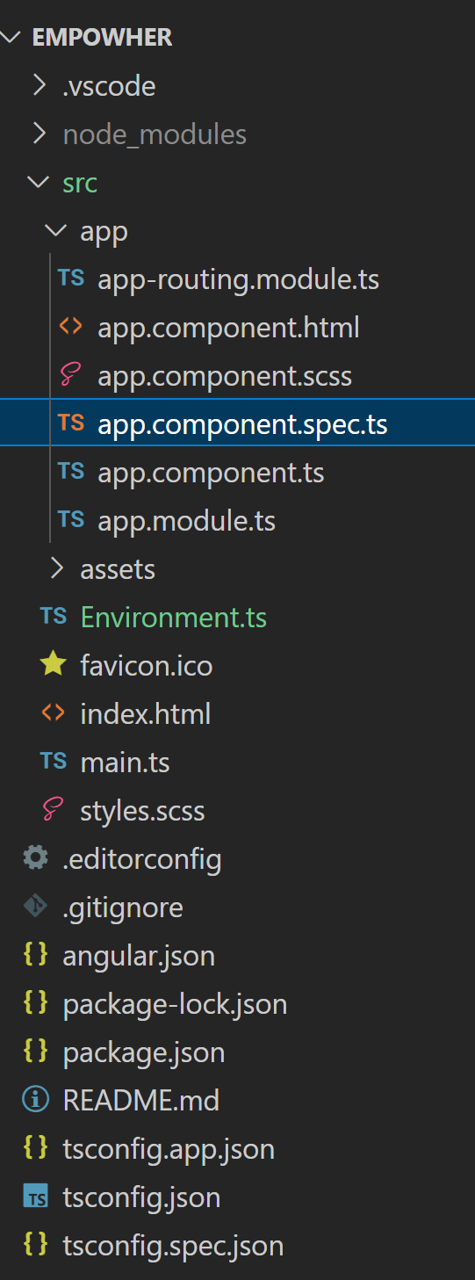
Week3: Angular Project Folder Structure
Angular Project Folder Structure
When you create a new Angular project using the Angular CLI, it generates a specific folder structure:
node_modules: Contains the npm packages necessary for your project.
src: Contains your source files. This is where you'll spend most of your time.
.editorconfig: Configuration for your editor.
.gitignore: Specifies which files should not be tracked by Git.
angular.json: Configuration for Angular CLI. In this file, you can set several defaults and configure
what files are included in your project.
package.json: Lists the packages your project depends on.
tsconfig.json: Configuration for the TypeScript compiler.
tslint.json: Configuration for TSLint.
e2e: Contains end-to-end tests.
In the src/ folder, you'll find:
app: Contains the component files where your application logic resides.
assets: A folder to store images and any static assets.
environments: Contains environment configuration files.
index.html: The main HTML page.
main.ts: The main entry point for your app.
styles.css: Global styles for your app.

Slide 16
Topic Week 2: Ng Generate commands
In Angular, the ‘ng generate’ command is used to create various components, modules, services and other files to help build the application. Commonly used ng generate commands are-
Ng generate component component_name
Ex: Ng generate component test
test.component.ts (Class with @Component decorator)
test.component.spec.ts (For test case specification)
test.component.html (For the template)
test.component.css (For stylesheets)
Once the component is created the above 4 files will be created ,there is one file which will be updated called app.module.ts, as we have to reference the newly created component to our root module file so the Angular CLI automatically does the job while generating the component.
Other commonly used ng generate commands are:
ng generate config [type]
ng generate directive [name]
ng generate enum [name]
ng generate environments
ng generate interface [name] [type]

Slide 17
Topic Week 2: Lifecycle
Components are the main building block of an Angular application.
Each component has a lifecycle that it goes through from creation to destruction.
The lifecycle is managed by Angular as it creates, checks, updates, and eventually destroys a component.
Angular provides lifecycle hooks that give visibility into these key life moments and the ability to act when
they occur. Some of the main lifecycle hooks are:
ngOnChanges(): Called before ngOnInit() and whenever one or more data-bound input properties change.
ngOnInit(): Called once the component is initialized.
ngDoCheck(): Called during every change detection run.
ngAfterContentInit(): Called after content (ng-content) has been projected into the component.
ngAfterContentChecked(): Called after every check of component content.
ngAfterViewInit(): Called after the component’s view (and child views) are initialized.
ngAfterViewChecked(): Called after every check of a component's view.
ngOnDestroy(): Called once the component is about to be destroyed.

